Slide 1


Integrated Farm Security System
Dare To Try
W Jose Vinoth (244613)
Innovista Pre Finals Finals Presentation

Slide 2
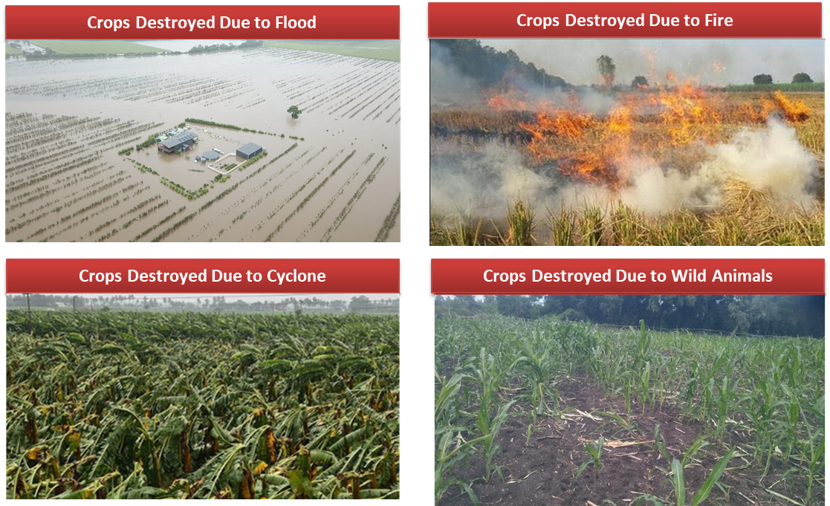
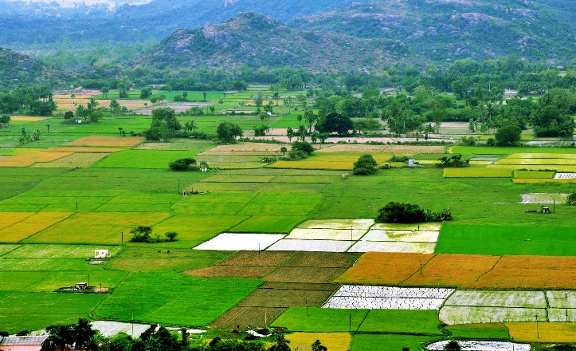
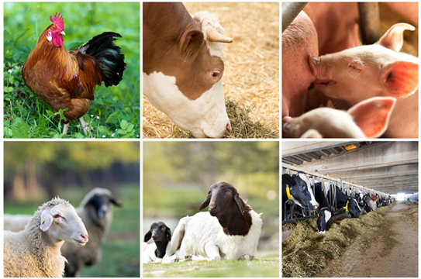
Overview
Agricultural Farm
Livestock Farm
Agriculture industry in India size reached INR 80,550 Billion in 2022.
Market to reach INR 158,991 Billion by 2028, exhibiting a growth rate of 12.2% during 2023-2028.
Animal interference in agricultural areas results in a significant loss of crops.
Wild animal raiding damage to crops has grown significantly in importance recently.
Elephants, Wild boars, macaques, porcupines, deer, monkeys, and bears, have the potential to cause significant damage, even human casualties
Due to the tight wildlife rules, small farmers may potentially lose up to 50% of their harvest.

Slide 3
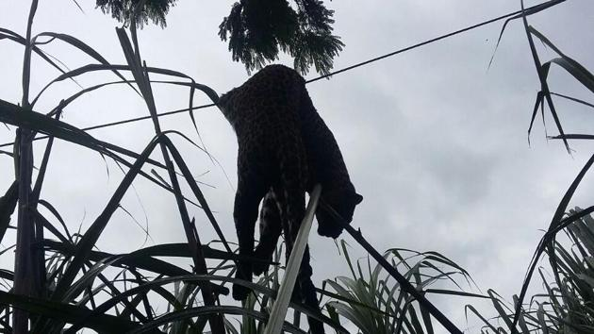
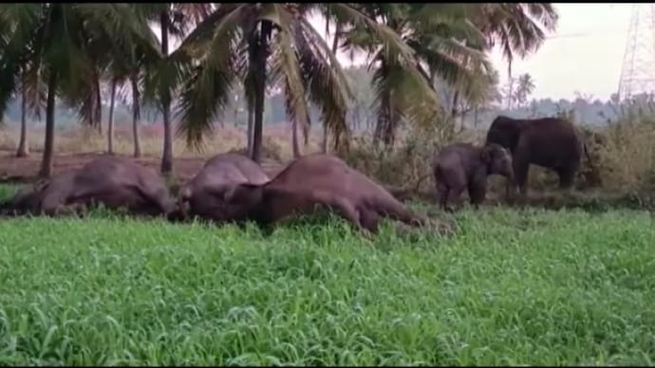
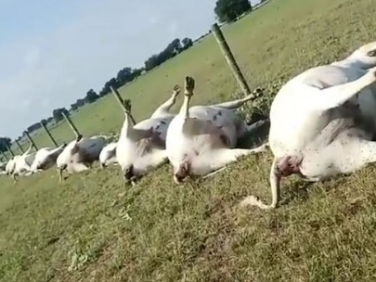
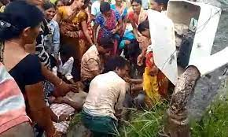
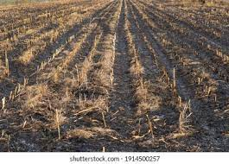
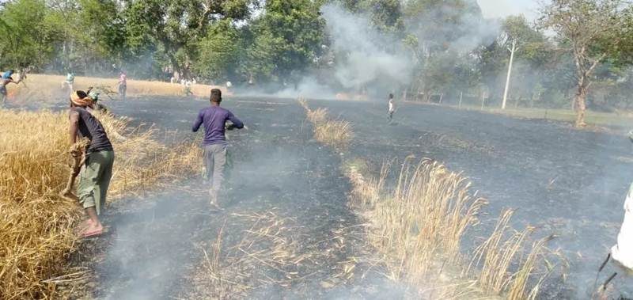
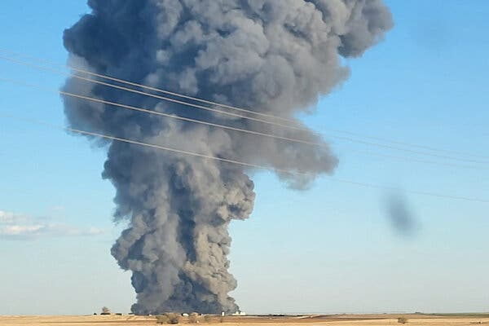
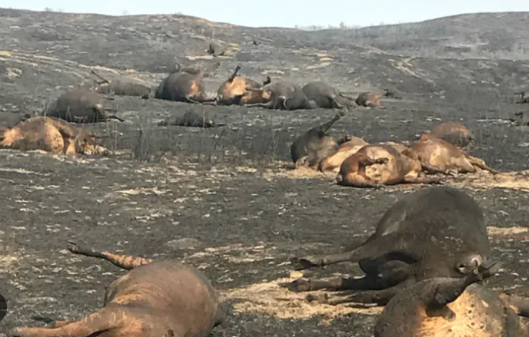
Cause-Effects & Losses
Around 1,300 wild animals had been electrocuted across India between 2010 and 2020, reveals a data compiled by NGO Wildlife Protection Society of India (WPSI)
Across India, 630 elephants died due to electrocution in the last decade with Assam topping the list with 120 elephants.
Over 500 elephants, 220 flamingos, 150 leopards and 46 tigers among other animals died of electrocution across the country
Over 100 farmer electrocuted in India between 2010 to 2020
According to the Uttar Pradesh Fire Service control room in Lucknow, on an average, 1,500 fire-related incidents are daily reported between march and June 2023 across the state. Close to Rs.1000 Crore loss to farmers
About 18,000 Cattle Are Killed in Fire at Dairy Farm in Texas

Slide 4
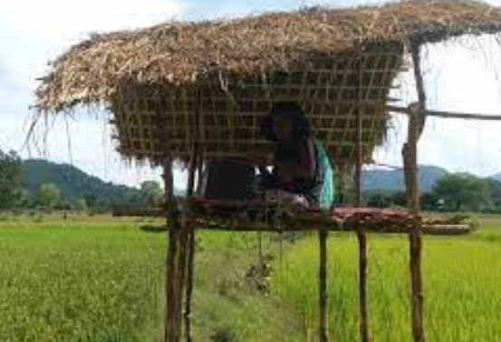
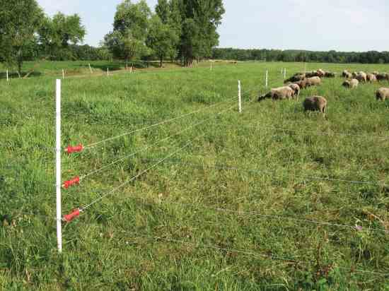
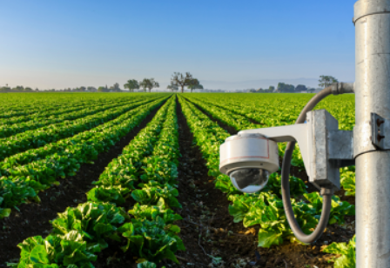
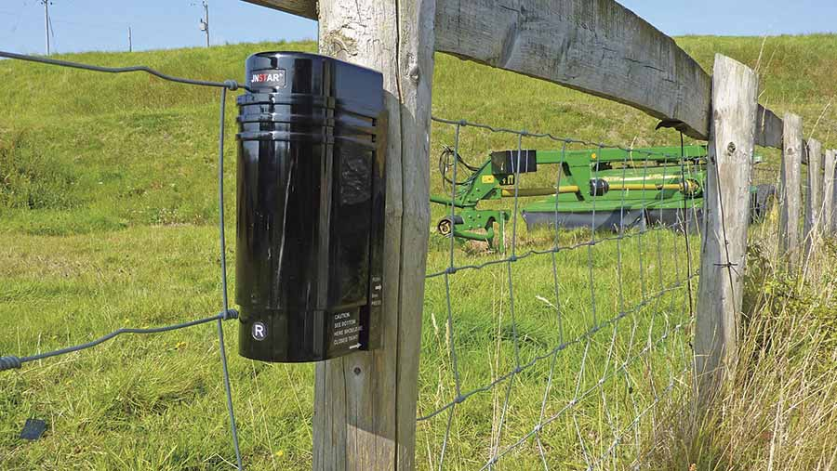

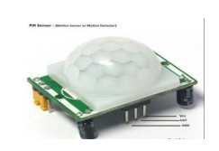
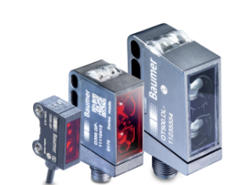
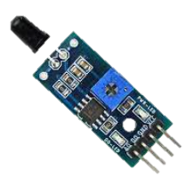
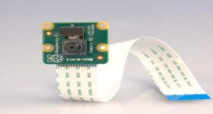
Farm Security System – Historic View
Electric Fences
CCTV Camera
Alarm System
Watch Towers
IOT Based Systems
Raspberry-Pi
PIR Sensor
Photoelectric Sensor
PiCam
Fire Sensor
Image Source: Google

Slide 5
Challenges & Solutions
Problem Statement
The largest industry in India is agriculture, but in the current economic climate, crop loss by wildlife has become a significant social problem.
Many farmers have relied on guards, electric fences to protect their crops, which raises overhead costs.
Animals, birds and human beings get electrocuted (Death due to electric shock)
Paddy, wheat, sugarcane fields get destroyed due to fire accidents.
Disadvantages of Existing System
High cost.
Prone to seasonality.
Highly inefficient.
Requires costly equipment's and infrastructure
Injuries to animals/Harmful to animals.
Proposed Solution
Techniques for machine learning and computer vision (AI) can be used to recognize, animals, humans and detect fire.
Using computer Vision technology, once animals detected signals passed to alarm system which keep wild animals out of the farm fields.
Electricity control system to gradually reduce the intensity of electricity in farm fences which could induce negligible harm to animals/humans.
This approach condemned the entire safety of crops from animals, preventing the farmer's loss

Slide 7
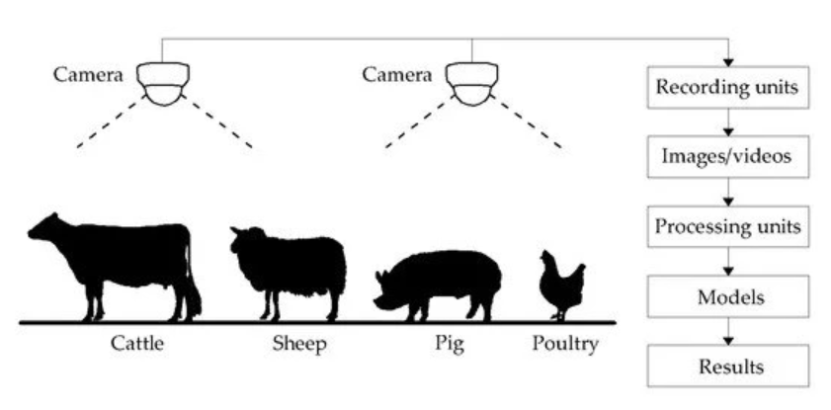
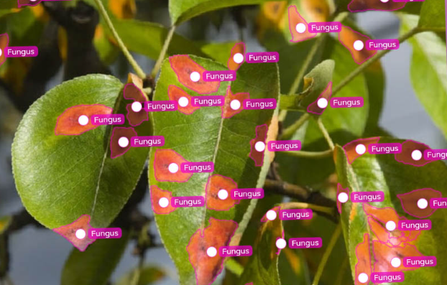
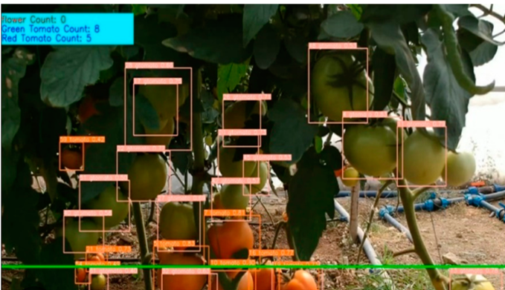
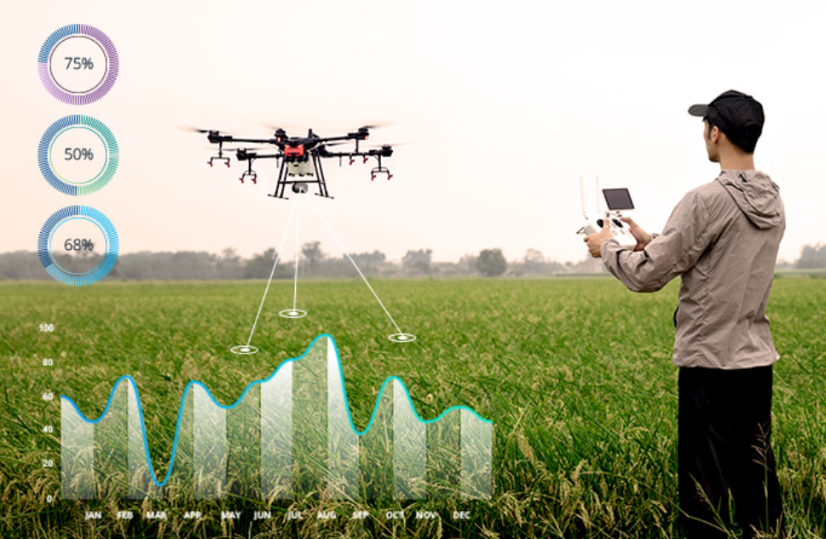
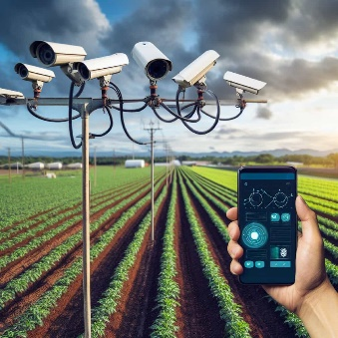
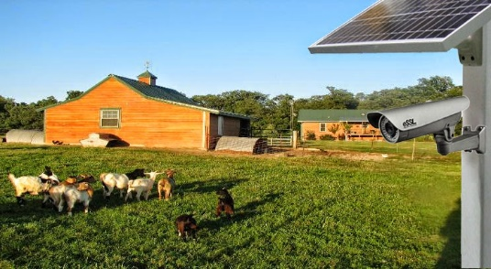
Top Applications of Computer Vision in Agriculture
Computer Vision Systems in Livestock, Poultry & Fish Farming
Yield Estimation With Fruit or Vegetable Counting
Drone-Based Crop Monitoring with AI
Security Monitoring for Remote Farms
Image Source: Google
Notes:
Computer Vision Systems in Livestock Farming, Poultry & Fish Farming
Computer Vision Systems in Livestock Farming Food security is one of the world’s biggest challenges.
Livestock and poultry contribute to a large proportion (30%) of the daily protein intake through products like meat, milk, egg, and offal. Animal production is expected to increase accordingly to feed the growing human population.
As production is intensified to meet the increased demands, producers are confronted with increasing pressure to provide quality care for an increasing number of animals per management unit. This becomes even more challenging given the expected labor shortages for farm jobs in the future.
Computer Vision systems monitor animals such as cattle, sheep, pigs, or others with cameras. Neural networks are used to analyze video feeds in real time.
The advantages of computer vision systems root in their automatic, non-invasive, and low-cost animal monitoring capabilities.
AI vision systems allow information extraction with minimal external inferences (human adjustment of sensors, maintenance) at an affordable cost.
Computer Vision Systems in Poultry farming
Advanced deep learning algorithms are robust enough to be applied in poultry farming.
The term “poultry” includes a range of domesticated species, including chickens, turkeys, ducks, geese, game birds, and ratites (e.g., emus and ostriches).
In poultry farms, computer vision technology aims to prevent diseases and ensure food security while enhancing overall productivity by lowering costs and providing information to increase product quality.
Today, computer vision is widely used in poultry production systems.
It includes house management automation, behavior analysis, animal welfare, disease detection, weight measurement, egg examination, and more.
Computer Vision Systems Fish Farming
Automatic fish detection with computer vision is an important tool in precision farming for achieving automatic fish detection.
Especially, deep learning methods have shown great potential in fish species identification, counting, and behavior analysis.
Also, computer vision is rapidly developing to be used in effective intelligent feeding systems. Such systems are based on underwater image preprocessing, fish detection, fish weight and length estimation, fish behavior analysis.
Fish counting is still a rudimentary process in many fisheries.
Computer vision based systems provide a cost-efficient method for counting fish with deep learning.
Automatic fish counting reduces costs, helps to boost production, and increases labor availability. For example, computer vision has been used for automatic live fingerlings counting.
Related novel use cases for aquaculture enterprises involve analyzing the integrity and safety of fishing nets with deep learning machine learning technology.
Yield Estimation With Fruit or Vegetable Counting
Yield estimation is an essential preharvest practice among most large-scale farming companies.
It supports decision-making for allocating essential logistics such as transportation means, labor force, supplies, and more.
An overestimation leads to further costs that impact profitability; underestimation entails potential crop waste and additional costs.
Yield prediction is also used to optimize cultivation practices and plant disease prevention.
Deep convolutional network algorithms are developed to facilitate the accurate yield prediction and automatic counting of fruits and vegetables on images.
Modern deep learning methods provide good accuracy even with occlusion caused by leaves or branches, illumination, and object size.
Manual yield estimation with the counting of products such as fruits or vegetables is very time-consuming and expensive.
Computer vision approaches can be used for the automatic counting of fruits or flowers. An example is the automatic on-tree counting and yield estimation of kiwifruit.
Security Monitoring for Remote Farms
Real-time surveillance and security monitoring for remote farms is another current application of ML in smart farming.
Such monitoring and notification systems are of high importance to farms.
The images detected with common surveillance systems can be processed by AI algorithms to perform intrusion detection and automatically identify anomalies, fire detections, flood detection, animal detection.
Integrated IOT system with AI helps to monitor and control electricity passed through fencing to avoid any loss in life.
Modern methods use deep neural networks to perform accurate face recognition that is invariant to changes in illumination.
This makes it possible to implement deep face recognition in multiple remote farms.
Drone-Based Crop Monitoring
Over the last few years, drone technology has gained huge popularity because of its autonomous flying capabilities.
Drones have become a significant element in precision agriculture and farming.
Because of their flying abilities and cover a large distance, drones can capture huge volumes of data with a built-in camera.
Computer vision algorithms are trained with the captured footage to detect the soil conditions, analyze the aerial view of the overall agricultural land, and assess crop health information based on geo-sensing information.
Therefore, the images are labeled with image annotation to create training data for algorithm training.
The AI models perform object detection and semantic segmentation to recognize objects and conditions in drone footage.

Slide 8
Flowchart of Proposed System
Start
Human?
Animals?
Send message and email alert to Owners
Object Detected?
Activate Alarm System
Activate Alarm System
Collect Image in Raspberry Pi media
Put off Electric Fence
Control Electric Fence Voltage
Image Processing
Using OpenCV DNN module

Slide 9
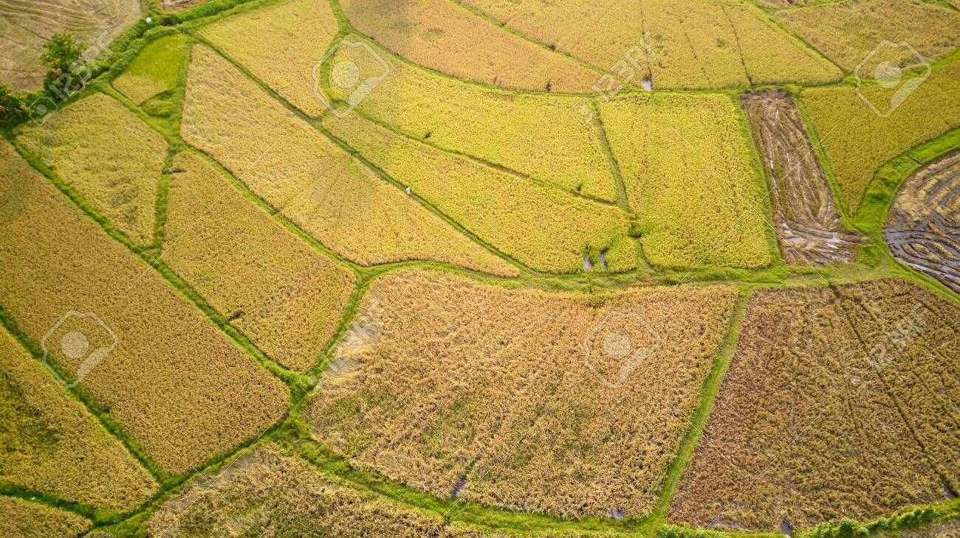




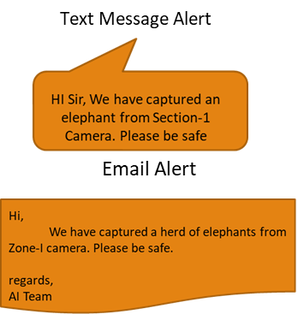
Integrated Farm Security System - Unique Solution
Siren Volume increases according to animal category
Human Detected in application
Electric Fence
Surveillance Camera
Control Fence Voltage or Put-off
Fence Power Control System

Slide 10
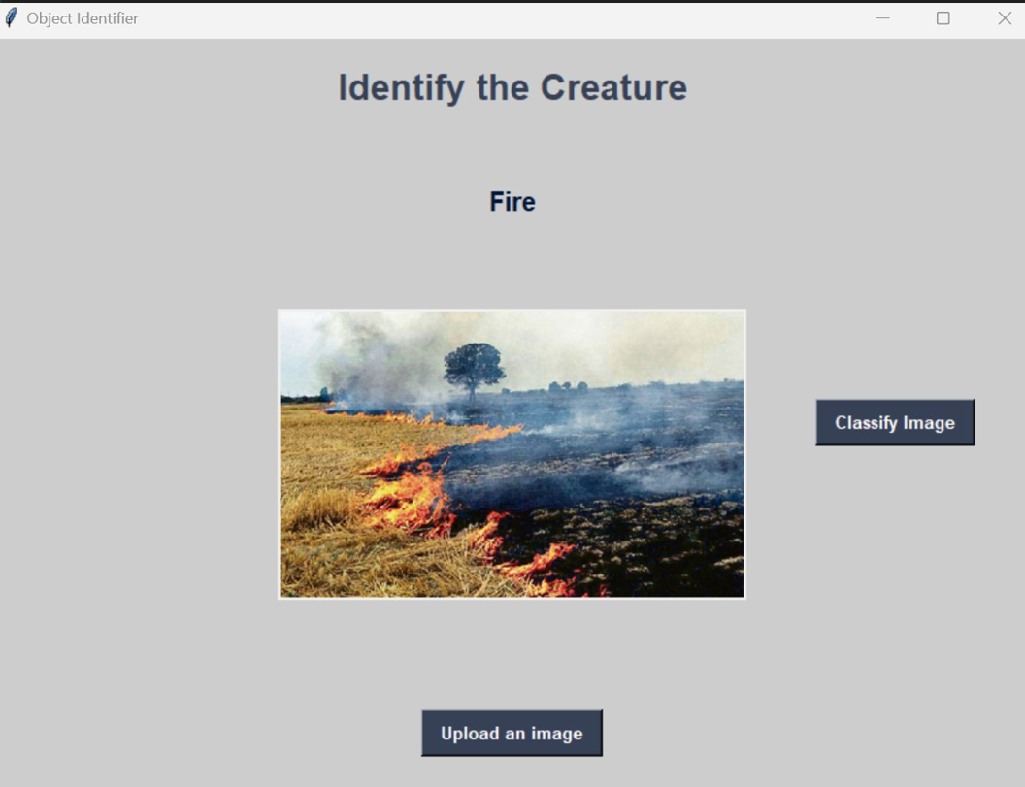
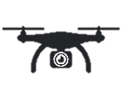


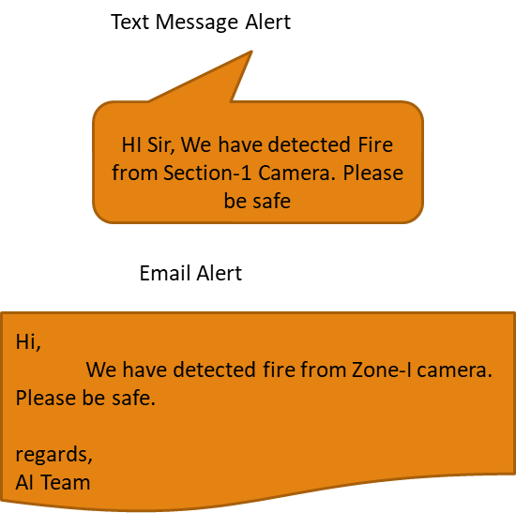
Integrated Farm Security System - Unique Solution
Siren Alert
Fire Detected in application
Drone With Fire Extinguisher Balls
Fire in Farm
Surveillance Camera
Activate Drones to put off fire using fire extinguisher balls
Fire Protection Control System

Slide 11



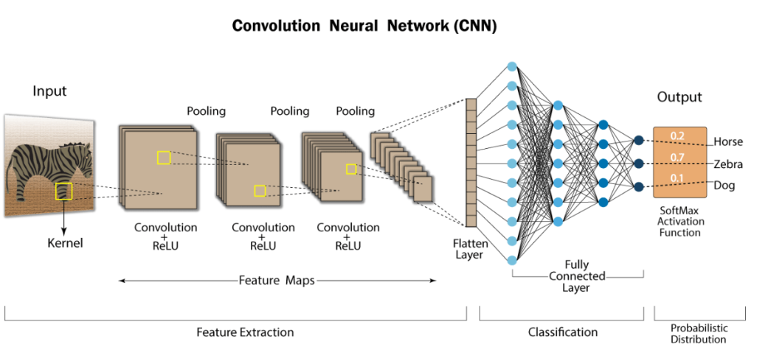


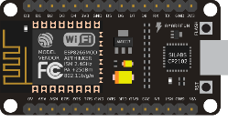

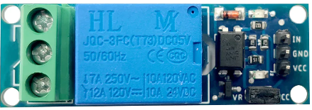
Architecture
Mobile Message Alert
Email Alert
Surveillance Cameras
Convolution Neural Network – Trained Model
Electric Fence Voltage
Voltage Regulator/ Energizer
Relay
(Automatic Electric Switch)
NODEMCU ESP8266
(Microcontroller)

Slide 12
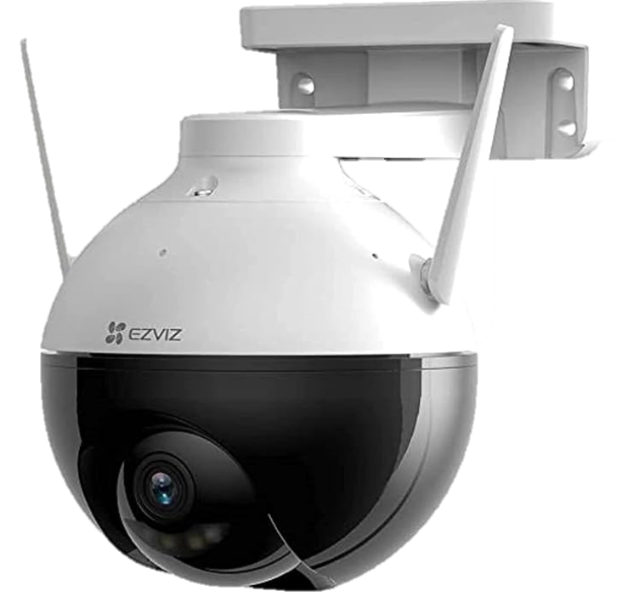

Experimental Cost – Rough estimate for 1 acre Land
Accessory | Description | Cost (INR) | Qty | Total (INR)
Hikvision Camera | C8C Outdoor WiFi 1080p Motorized Pan/Tilt Camera,Color Night Vision, Dust and Water Protection, BuiltIn MicroSD Card Slot | 3500 | 20 | 70000
Installation Setup | Connecting wires, cables, steel post etc | 1,00,000 | 1 | 1,00,000
 | t2 large instance with 32GB, 8 core | 50,000 | 1 | 50,000
Total |  |  |  | 4,45,000

Slide 13
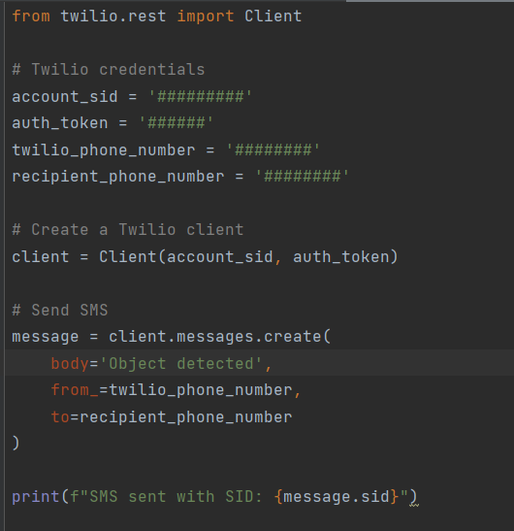

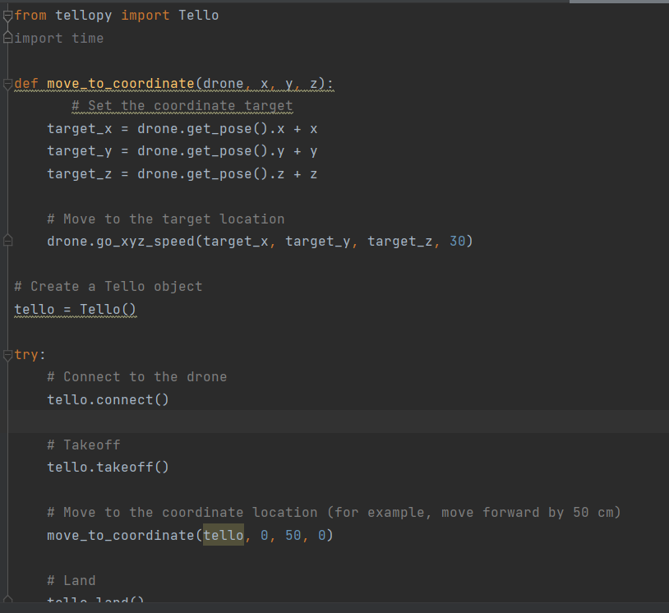
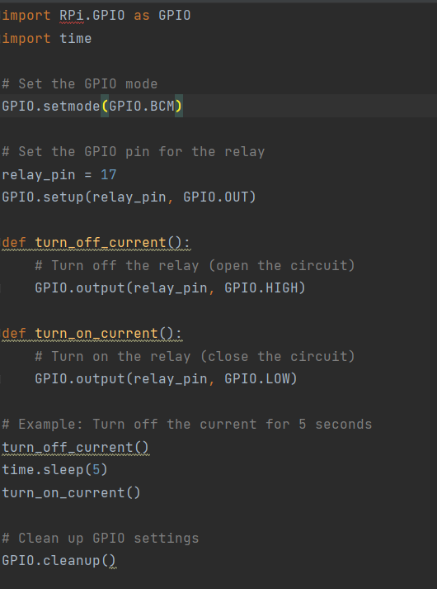
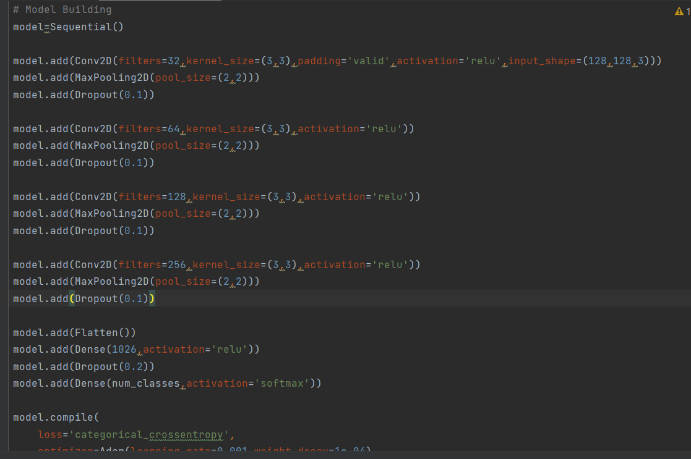
Code Screen shots
Message Alert
Email Alert
Drone Control
Voltage Control
CNN Model
Document Classification

Slide 14
Potential Business Opportunity
The Economic Survey of India 2023 highlighted that India’s agriculture sector has grown 4.6 per cent over the last six years with over 1000 agri-tech start-ups having emerged in the sector.
Agriculture industry in India contributes significantly to the country's economy, accounting for approximately 16 per cent of the GDP and employing 44 per cent of the national workforce.
Ernst & Young Report estimates that agri-tech startups in India offer an opportunity of $ 24 billion, and the industry is still significantly untapped.
The rural micro-finance industry went from INR 1.22 trillion in December 2019 to INR 1.46 trillion in March 2021.
Private equity investment in agri-tech businesses to increase by 50 percent, totaling INR 66 billion.
Document Classification

Slide 15
Thank you
Copyright © 2021 Tata Consultancy Services Limited

Slide 16
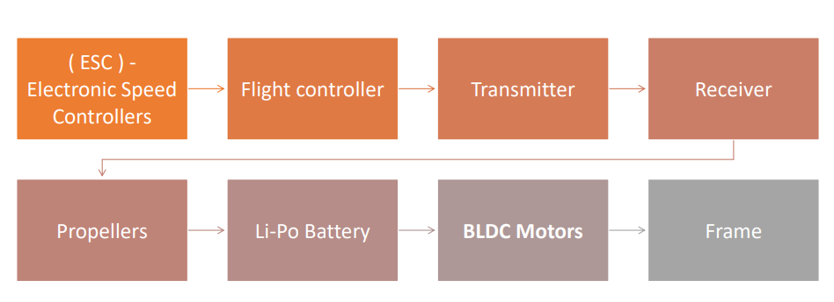
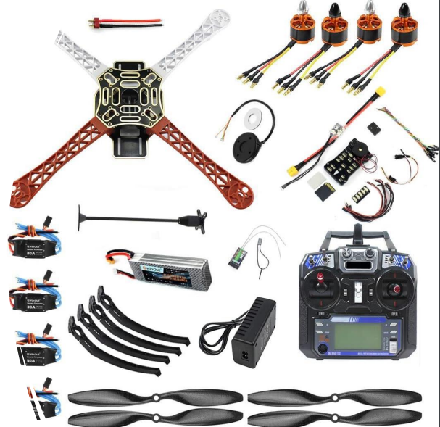
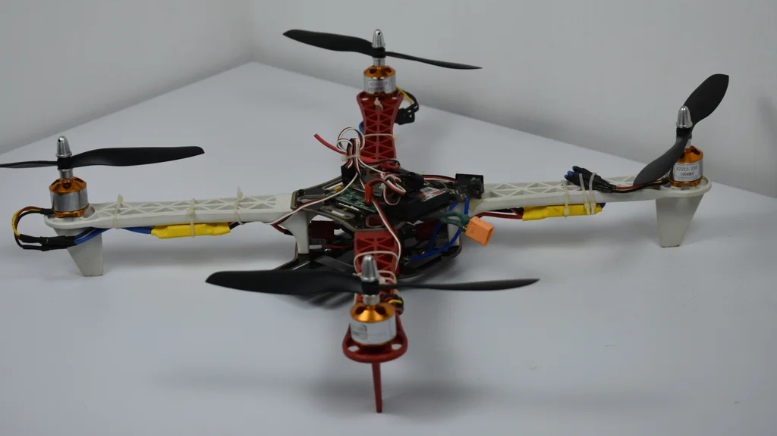
What's Next?
Document Classification

